Slide 1
Movie Production Studio
Author: Joan Maina

Slide 2
Outline
Business Problem
Data
Methods
Results
Conclusions

Slide 3
Business Problem
Microsoft wants to venture into movie production and have decided to create a movie studio.
They however have no information on to guide their decision.
They need to know the types of movies doing well at the box office and actionable insights to inform their course of action.
The approach taken with the analysis seeks to look at
The revenue/profit margins in the industry
Type of movie that would be successful by exploring the genres, production budget and runtime(length) of the movie.
The relationship between the budget, genre and runtime of the movie

Slide 4
Data
Data for this project was obtained from the Phase 1 Project Repository.
In the repository's folder zippedData, are movie datasets from:
Box Office Mojo
IMDB
Rotten Tomatoes
TheMovieDB
The Numbers
The data represents movies by genre, budget, grossing at the Box office, release year, runtime, date of release, number of reviews, movie rating and the studios involved in production.
These are the variables this analysis will focus on to derive insights.

Slide 5
Methods
The process can be divided into three main parts.
The first focuses on data preparation.
The steps include:
- Importing libraries
- Reading and cleaning provided data
- Dealing with missing values
- Joining datasets
Second section focuses on visualizations and insights.
For each characteristic we will be:
- Creating visualizations
- Drawing conclusions
- Providing recommendations
Finally a summary of the findings and recommendations will be in the last section.

Slide 6
Results
The profit analysis for the industry showing results for:
Profits over the years
Profits per genre
Profit relationship to worldwide gross
Profit in relation to the runtime
Profit in relation to the budget

Slide 7
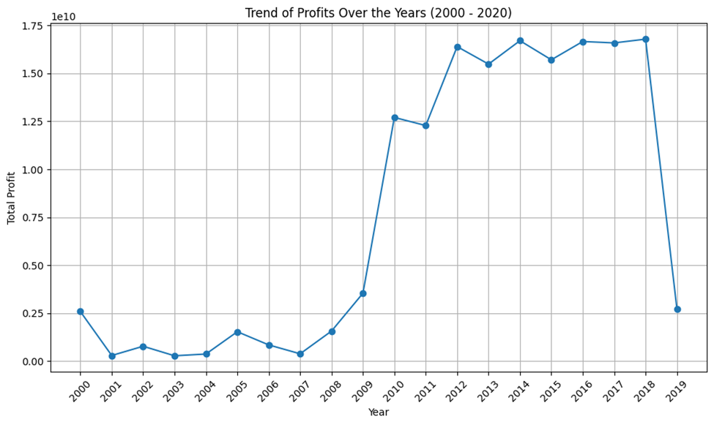
A trend of profits over the year 2000-2020
The trend of profits has been fluctuating erratically over the years

Slide 8
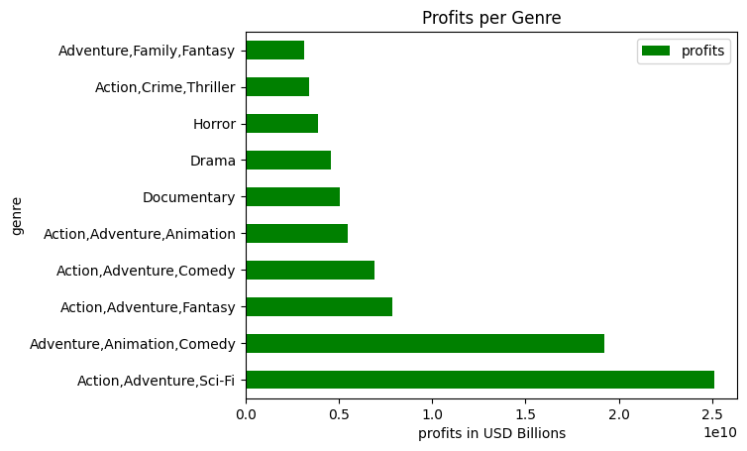
Profits per genre
Action,Adventure, SciFi productins will resulted in highest profit among the genres.

Slide 9
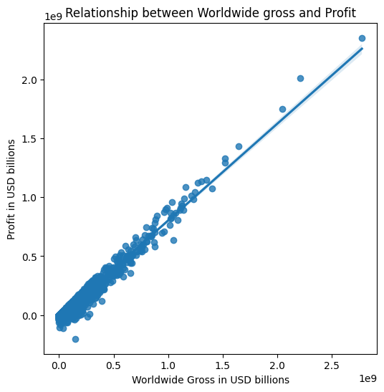
Relationship between Worldwide gross and profits
There is a direct relationship between worldwide gross and profits.
This is an indication that high grossing movies, genres result in high profits

Slide 10
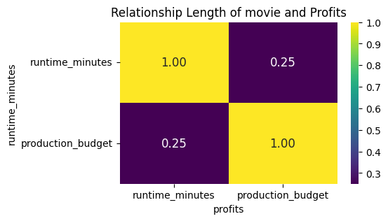
Correlation between the length of the movie and the profits
There is a very low correlation between the length of the movie and the profits.

Slide 11
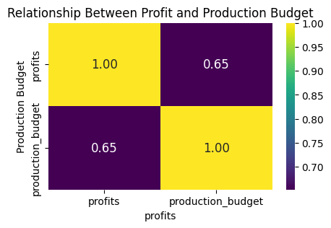
Correlation between the production budget and the profits
There is a high correlation between the production budget and the profits. This shows that the more investment put into production, the more revenue is earned.

Slide 12
Market analysis
Shows results for
Distribution of profits among the studios
Distribution of genres among the studios

Slide 13
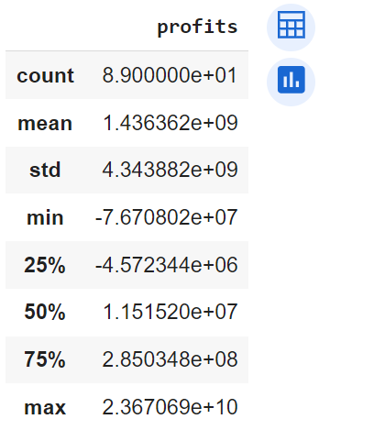
Distribution of profits among the studios
From the data we can see that there are 89 studios in the market.
The mean profit in the industry is USD 14B. This is indicative of how much revenue could be brought by venturing into the market.

Slide 14
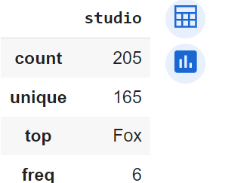
Distribution of genres among the studios
The Fox studio has a has the widest range production across the genres at 6.
Given it is the 3rd highest among the most profitable studios it could indicate that versatility in production could mean more profits.

Slide 15
Conclusions
There is a high correlation between profit and worldwide gross. If the grossing of a movie is high then this is an indicator that the profit is also high.
The highest grossing genre is Action,Adventure, SciFi genre will result in higher profits than the rest of the genres.
The length of a movie does not directly affect its grossing value/profits.
Production budgets highly affects profits. A big investment in budget could result in a high profit.
Production in a variety of genres could result in a high revenue for the movie studio.

Slide 16
Recommendations
With the market mean budget at USD 38.8B, a budget film above this will see a return of Usd 14.3B.
Investing in mix of genres is recomended.

Slide 17
Thank You!
Email: joan.maina@student.moringaschool.com
GitHub: @JoanWaMaina

